Slide 1
Word Lesson 1 Microsoft Word Basics
Microsoft Office 2010 Introductory
Pasewark & Pasewark

Slide 2
Objectives
Start Word and understand the ways to view your document.
Enter text in a document and navigate a document.
Use Backspace and Delete to correct errors.
Save a document.
Open an existing document.
2
2

Slide 3
Objectives (continued)
Use Full Screen Reading view.
Change the page orientation of a document. Preview and print a document.
Exit Word.
3
3

Slide 4
Vocabulary
Draft view
Full Screen Reading view
insertion point
landscape orientation
Outline view
portrait orientation
Print Layout view
Quick Access Toolbar
Ribbon
status bar
Toolbar
view buttons
Web Layout view
word processing
word wrap
Zoom
4
4

Slide 5
Introduction to Word Processing
Word processing is the use of computer software to enter and edit text.
You can easily create and edit documents, such as:
Letters
Reports
Newsletters with pictures and graphics
5
5

Slide 6
Starting Word
Click the Start button on the taskbar.
Click All Programs on the Start menu.
Click the Microsoft Office folder.
Click Microsoft Office Word 2010.
6
6

Slide 7
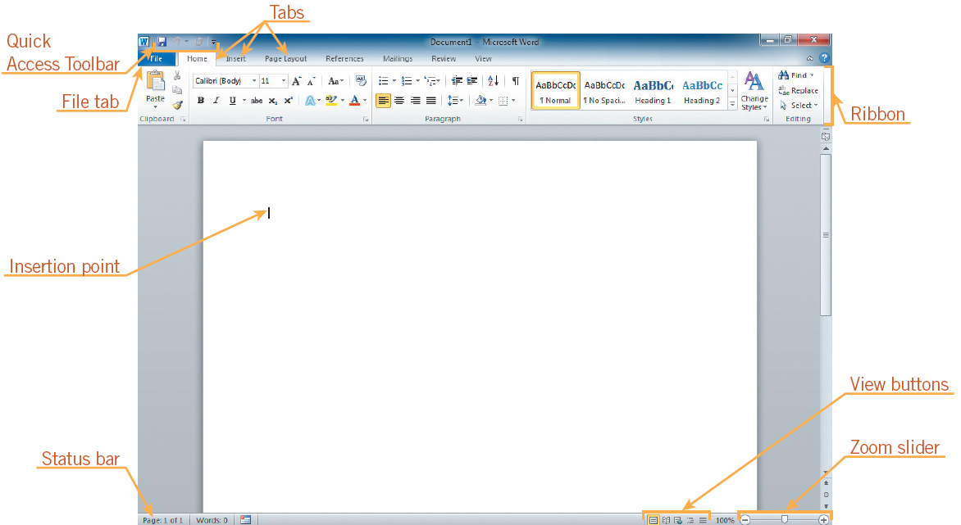
Starting Word (continued)
Opening screen in Word
7
7

Slide 8
Identifying Parts of the Word Program Window
Understanding the Word program window
8
8

Slide 9
Understanding Document Views
Document views
9
9

Slide 10
Inserting Text and Understanding Word Wrap
To enter text in a document, begin typing.
When you reach the right margin, the text continues on the next line. This feature is called word wrap.
When you press the Enter key, a blank line is inserted automatically, and you start a new paragraph.
10
10

Slide 11
Navigating a Word Document
To enter or edit text, use the mouse or keyboard to reposition the insertion point.
Mouse: Move the mouse until the insertion point is where you want it to appear.
Keyboard: There are many options of keys to use, including arrows, Page Down, Page Up and shortcuts.
11
11

Slide 12
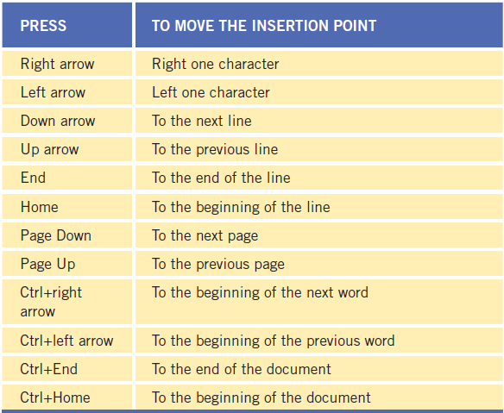
Navigating a Word Document (continued)
Keyboard shortcuts for moving the insertion point
12
12

Slide 13
Using Backspace and Delete
There are two ways to delete characters:
Backspace key: Deletes the character to the left of the insertion point
Delete key: Deletes the character to the right of the insertion point.

Slide 14
Saving a Document
To save a document for the first time:
Click the Save button on the Quick Access Toolbar.
Click the File tab, and then on the navigation bar, click the Save or Save As command.
Save command: Copies over previous version
Save As command: Used to save a document under a different name or location.
14
14

Slide 15
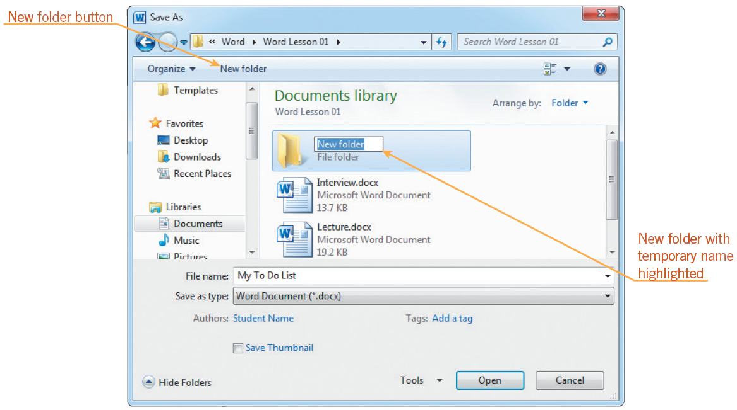
Saving a Document (continued)
Folders help you organize files.
Create a new folder in the Save As dialog box.
Save As dialog box after creating a new folder
15
15

Slide 16
Locating and Opening an Existing Document
To open documents click the File tab, then on the navigation bar, click
Open to open an existing document.
Recent to open a recent document.
New to open a new, blank document.
16
16

Slide 17
Zooming a Document
You can use the Zoom feature to magnify and reduce your document on screen.
A zoom percentage of 100% shows the document at its normal size.
The easiest way to change the zoom percentage is to drag the Zoom slider at the bottom-right of the screen.
17
17

Slide 18
Switching to Full Screen Reading View
Full Screen Reading View removes the Ribbon and the status bar from the screen.
The Ribbon is replaced by a small toolbar
To use this view, click the View tab on the Ribbon, then in the Document Views group, click the Full Screen Reading button.
18
18

Slide 19
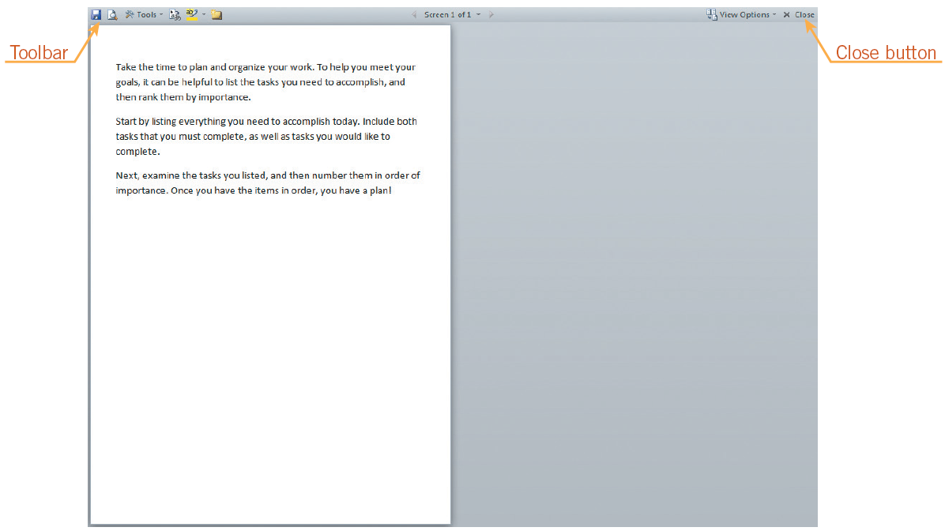
Switching to Full Screen Reading View (continued)
Document in Full Screen Reading view

Slide 20
Selecting a Page Orientation
Documents printed in portrait orientation are longer than they are wide.
Documents printed in landscape orientation are wider than they are long
By default, Word is set to print pages in portrait orientation.
20
20

Slide 21
Previewing and Printing a Document
Use the Print tab in Backstage view to preview a document before printing.
Use the Print tab to change print settings.
To print a document, click the Print button in the center pane on the Print tab in Backstage view.
21
21

Slide 22
Exiting Word
To close the document without exiting Word, click the File tab, and then on the navigation bar, click the Close command.
To exit Word, click the Close button in the upper-right corner of the document window.
22
22

Slide 23
Summary
In this lesson, you learned:
You can view the document screen in Print Layout view, Full Screen Reading view, Web Layout view, Outline view, and Draft view. The key elements of the screen in Print Layout view are the Ribbon, Quick Access Toolbar, insertion point, status bar, view buttons, and Zoom slider.
When text is entered, the word wrap feature automatically wraps words to the next line if they will not fit on the current line.
23
23

Slide 24
Summary (continued)
When corrections or additions need to be made, you can place the insertion point anywhere within a document using the mouse or keyboard, and then delete text using Backspace and Delete.
When you save a document for the first time, the Save As dialog box opens. This is where you name your file and choose a location in which to save it. After you have saved a document the first time, you use the Save command to save your changes in the document or use the Save As command to save it with a different file name or to a new location.
24
24

Slide 25
Summary (continued)
You can create new folders for storing documents in the Save As dialog box.
You can locate and open an existing document using the Open dialog box.
You can use the Zoom slider to magnify or reduce the size of your document on the screen.
Full Screen Reading view makes it easier to view the entire document on the screen by removing the Ribbon and status bar and displaying only the text, not the layout, of the document.
25
25

Slide 26
Summary (continued)
You can use the Orientation command to change the page orientation to portrait orientation or landscape orientation.
You can preview and print a document by using the Print tab in Backstage view.

